Slide 1
  The Complete Calibration of the Color-Redshift Relation (C3R2) Survey
Dan Masters (IPAC/Caltech)
+Dan Stern, Peter Capak, Judy Cohen, Jason Rhodes, Bahram Mobasher, Dave Sanders, Stephane Paltani, Francisco Castander, Audrey Galametz, Euclid photo-z team
Sendai Photo-z Meeting
May 19, 2017
Notes:
Overall structure of the talk is:
Statement of the problem, the evolution of line ratios, implications for metallicity measurement etc.
Some history: proposed solutions, their shortcomings
The idea: use local galaxies from SDSS
Show the empirical correlations
Physical interpretation, just MZ evolution + N/O-M*. Locally, it’s the FMR+N/O-M*
A diversion to nitrogen and its origin
Implications of results
Open questions

Slide 2
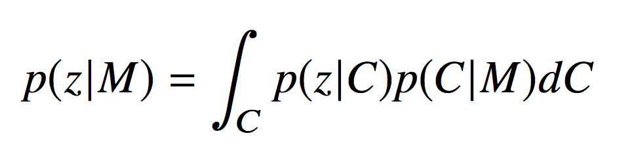
High-level motivation
  Want to constrain the true relation of redshift to color, p(z|C), with spectroscopy, cluster-z, overlapping deep multiband data, etc.
  The term p(C|M) implicitly depends on the density of sources in color space, ρ(C)
  We want constraints on p(z|C) spanning all regions of color space where ρ(C) is non-negligible

Slide 3
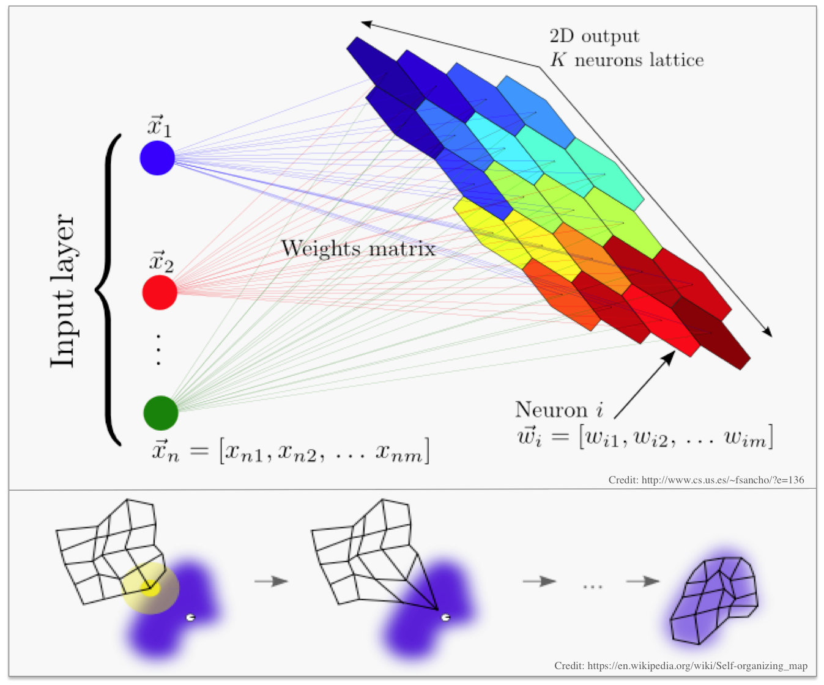
The SOM
  Just a useful tool to estimate ρ(C) for a given survey!

Slide 4
C3R2 survey strategy
  The ingredients of the survey: prior on galaxy properties (left), prior on unfilled parts of color space (center), prior on the occupation density of sources ρ(C) to Euclid depth, (right)

Slide 5
Target priorities
Weight sources in unsampled color cells more heavily
Weight sources with more common colors more heavily
  Also happens automatically
Avoid using “unusual” sources for calibration
High priority for sources with previously failed spectroscopy

Slide 6
Predicted exposure times
Use simulator (Peter’s talk) to estimate exposure times required with different instruments
Based on predicted SEDs / line strengths from fitting Brown et al. templates to COSMOS data
Require S/N=2 on the continuum near predicted emission line features for SF galaxies, S/N=5 on continuum near absorption features for passives
Estimates used as a first cut in designing masks, before applying C3R2 priorities

Slide 7
C3R2 progress
  Data release 1 paper ApJ accepted and on the arxiv: https://arxiv.org/abs/1704.06665
DR1 based on 5 Caltech nights in 2016A (PI J. Cohen), 1283 new high-quality redshifts
  Additional ~6% of map filled
DR2 will comprise 2016B/2017A nights:
  24 nights observed, ~14 good weather
    Combination of Caltech (PI Cohen), UC (PI Mobasher), NASA (PI Stern) and U. Hawaii (PI Sanders) time
    17 DEIMOS, 5 LRIS, 2 MOSFIRE
  Anticipate ~2500 new high quality redshifts
  Trying harder masks in comparison with 2016A

Slide 8
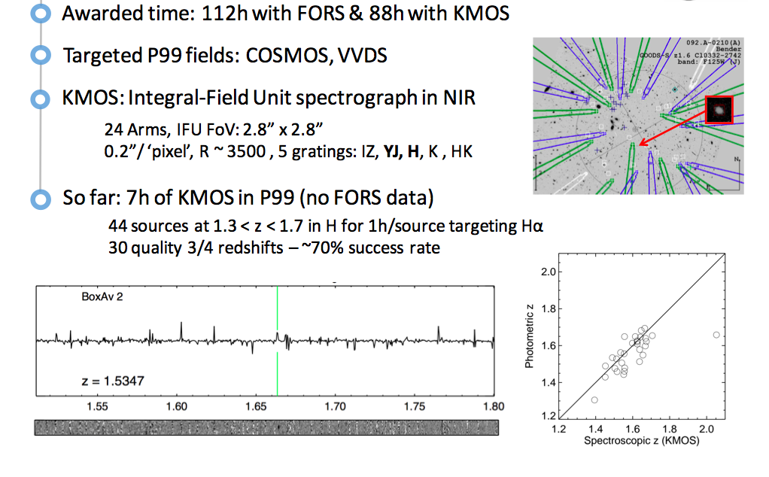
C3R2 VLT Large Program

Slide 9
DR1 spec-z sample properties

Slide 10
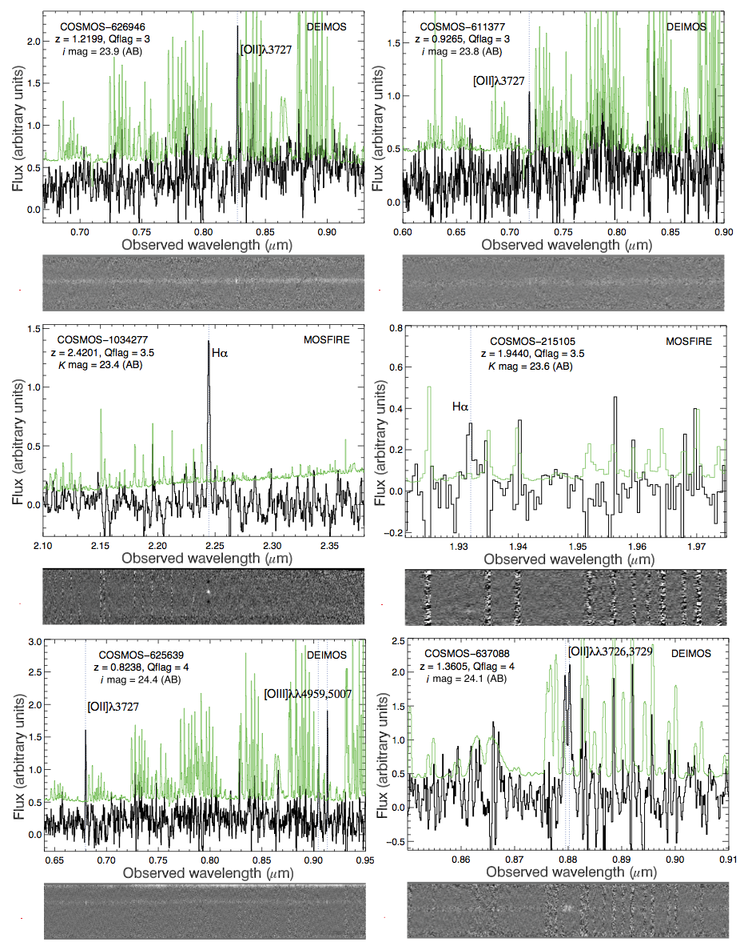
Sample spectra from DR1
  Lots of data, lots of redshifting
  Spectra examined by two independent reviewers, conflicts reconciled with the help of a third
  Quality flags and failure codes assigned

Slide 11
Photo-z results
Using Q=4 redshifts from DR1, and photo-z’s directly from the SOM (using the median of 30-band in each cell of color space)
Bias ~0.1% → within requirement, but preliminary. Interesting to achieve this with just (30-band) photo-z’s calibrating the map

Slide 12
Color coverage progress in DR1
C3R2 DR1 in COSMOS
Post-C3R2 DR1
Pre-C3R2 DR1

Slide 13
Performace
Performance of photo-z’s on the SOM suggests calibrating P(z|C) using high-quality photo-z’s from overlapping deep fields + spectra
  Hybrid calibration with spec-z + high-quality photo-z’s likely approaching “optimal” calibration of P(z|C)
Issues:
  Missed redshifts
  How to rescale for cosmic variance
  How to convince ourselves we have “enough” redshifts?
  Compare solution with cross-correlation?

Slide 14
Conclusions
Progress being made in mapping the color-redshift relation to Euclid depth
Highly accurate photo-z’s based on SOM method (using only 30-band COSMOS photo-z’s to define the P(z|C) relation)
Relevant quantity is fraction of calibrated galaxies, rather than fraction calibrated cells
~80% of galaxies now in calibrated cells
Next up: DR2 (~2500 new redshifts), extensive tests of the method using existing spectroscopy and simulations
Need to devise tests to convince ourselves and others that the method works

